Slide 1
👋 hello Reactathon
Notes:
Hello Reactathon.

Slide 2


Tyler Martinez
Notes:
My name is Tyler. I’m a software engineer at Docker based right here in San Francisco. At Docker I work on UI application in our enterprise stack.

Slide 3
UI at Docker
Notes:
At Docker we use many of my favorite technologies to build UI.

Slide 4

UI at Docker
Notes:
We use…

Slide 5



UI at Docker
Notes:
… React,

Slide 6


UI at Docker
Notes:
…Redux,

Slide 7
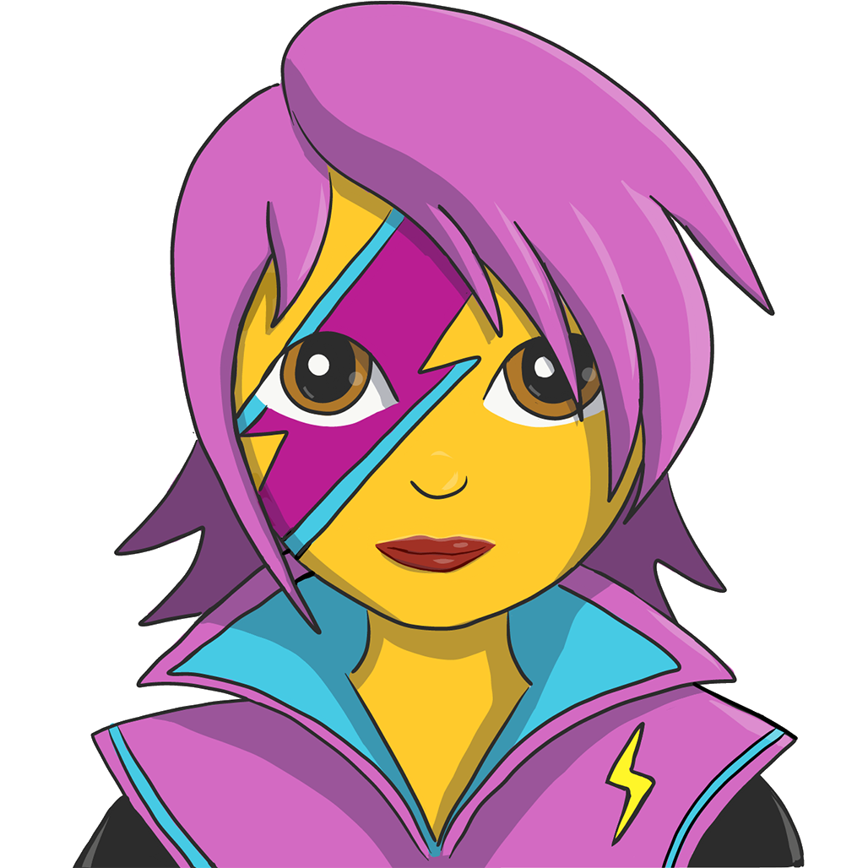

UI at Docker
Notes:
…Emotion,

Slide 8

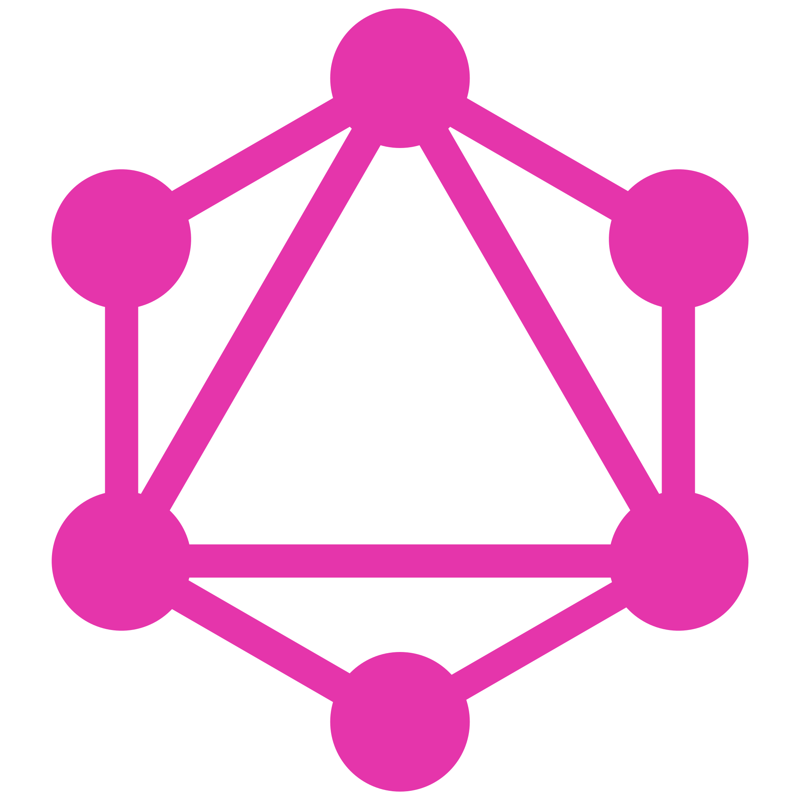
UI at Docker
Notes:
…and most recently… GraphQL.

Slide 9
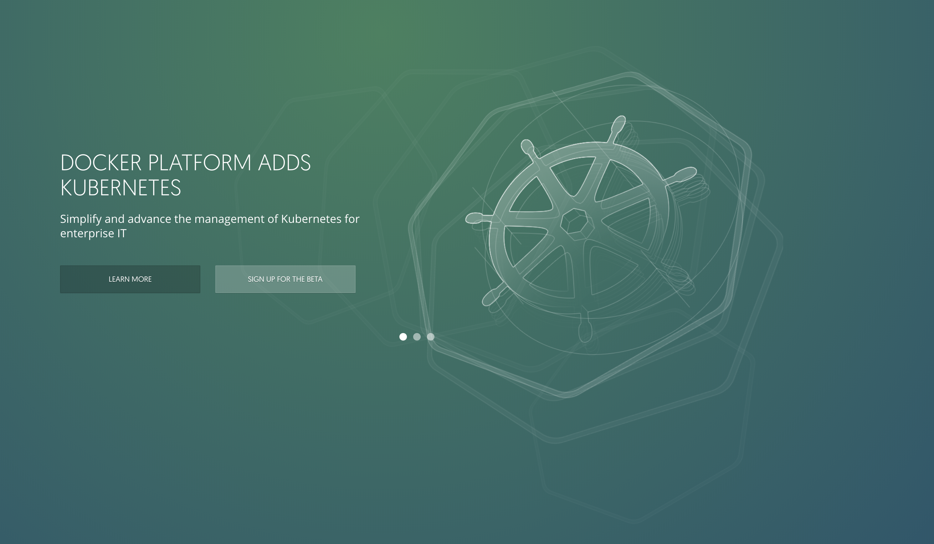
Notes:
So recent, actually, that we haven’t shipped a release with GraphQL yet. I was hoping we’d have wrapped up our release before I presented but… y’all know how releases go… In just a few weeks we’ll be shipping Docker Enterprise Edition 2.0…

Slide 10
Notes:
… which will be using GraphQL under the hood for the first time.

Slide 11
GraphQL at Docker
Notes:
Just a little context on my work at Docker — I work on one of our enterprise offerings that provides Docker image management, kinda like Docker Hub on prem. The product has been written in React + Redux since its inception and has been in production for several years. It is “enterprise” in that it is distributed to our customers and run on their own infrastructure by their own ops team.
This presents a different set of problems then the SaaS products that I’ve worked on previously. We have to be careful with the changes that we make to the application as our releases have immediate and historical effects. Missteps are costly and change can be slow.

Slide 12
GraphQL outside the box
Notes:
Adding GraphQL to a product like this took a different approach. We currently have a “public” REST API that has become limiting. Our data is complex, and our UI app had to compensate with an even more complex data layer to handle it. I knew that taking a different approach centered around GraphQL could drastically simplify our UI application.
Getting the support from the team on adding a GraphQL server to our stack was difficult. Understandably so, adding a server to our stack comes with some significant operations questions — doubly so as we’d likely be using Node JS, something else new to the team. How could we move the needle on GraphQL today?

Slide 13
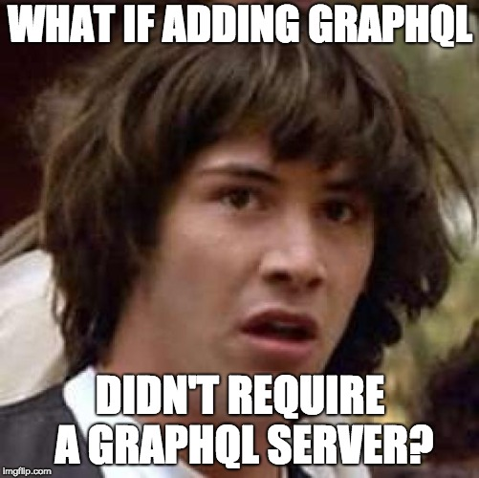
Notes:
What if adding GraphQL didn’t require a GraphQL server?

Slide 14
GraphQL outside the box
Notes:
Turns out it doesn’t. Adding GraphQL to an existing React application, even one using a REST API, is actually really simple. We can use the same set of technologies we’d use to write a Node GraphQL server. By eliminating the need for server infrastructure we can begin proving the value of GraphQL today, with an architecture that allows for a server side deployment in the future.

Slide 15
Implementation
Notes:
So what does this implementation look like? How do we actually run GraphQL on the end users device?

Slide 16

Implementation
Traditional
Notes:
In a traditional GraphQL setup we serialize requests made by components and then send them over the wire. On the server we hook an executable GraphQL schema up to a single HTTP endpoint, conventionally “/graphql”. The request is parsed and executed, with the response serialized and passed back over the wire.

Slide 17
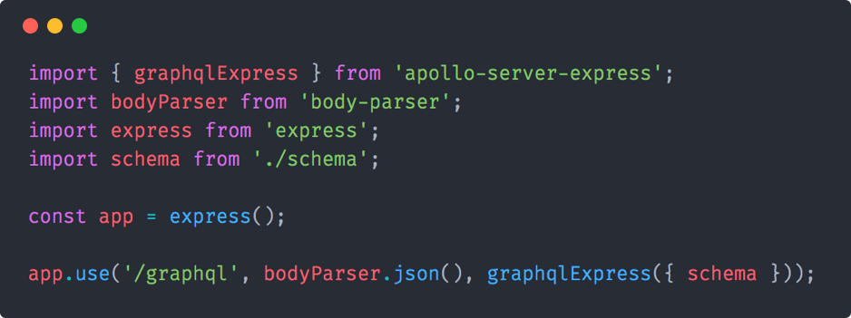
Implementation
Traditional
Notes:
Using the apollo-server packages a minimal implementation of a GraphQL server looks something like this. In a production setup the HTTP server would be more advanced (auth, logging, etc) but the GraphQL schema should remain unchanged. When correctly designed I believe the schema should be agnostic about the environment it gets executed in.

Slide 18

Implementation
On the client
Notes:
For our client side approach we simply take the GraphQL interface and include it in our UI bundle— right in-between our GraphQL client and our HTTP client. Instead of serializing the requests we pass them as JavaScript values directly to the schema. The schema’s revolvers call the HTTP client which makes network requests against our REST API.

Slide 19
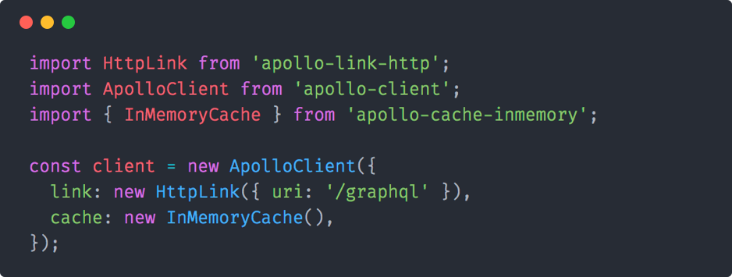
Implementation
Traditional
Notes:
Code wise it is incredible simple to do. In a traditional GraphQL app you would configure the apollo-client package to work with a remote HTTP server like this.

Slide 20
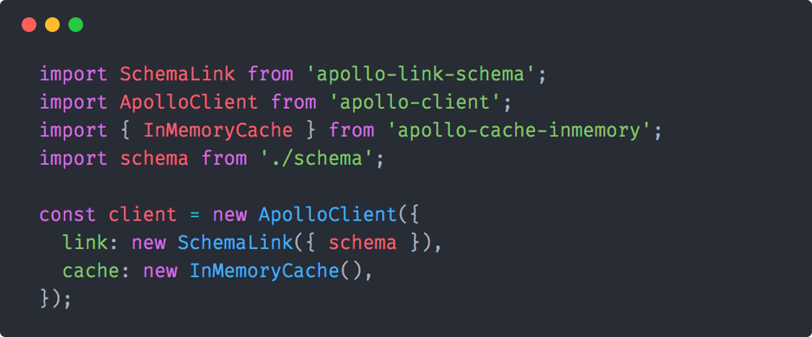
Implementation
On the client
Notes:
To accommodate our client side approach we make a small change. Instead of using the HTTP link we use a schema link (like the one also provided by the Apollo team) and pass in our schema.
This single configuration change is all that is required. Our components keep defining their data dependencies in the exact same way that we would if we had a remote GraphQL server. Our schema does not require any changes. As long as we’re using a universal HTTP client to make requests in our resolvers, the schema can be run in both browser and server side environments.

Slide 21
Why GraphQL?
Notes:
Implementation is simple enough. Other than the overhead of adding the GraphQL packages to our bundle the only serious cost to adding GraphQL to our application is the refactoring work required to use it. This is a non-trivial cost. If you’ve never worked with GraphQL you might think that that you just swap it out in the network layer — instead of making REST requests make GraphQL requests. It’s much more pervasive than that in my experience, requiring a large change in how we build our application.

Slide 22
Why GraphQL?
Better data layer
Better component APIs
Data modeling
Notes:
How do we justify such a large refactor to our application? GraphQL brings some key improvements to our application architecture, the largest being improvements to our “data layer”.

Slide 23

Why GraphQL?
Better data layer
Notes:
When I say “data layer” I’m referring to the state management, effect handling, and network layers in our app. We’re all here today to learn about and discuss React, ostensibly a “view” library. The thing is that the view layer of our applications are actually really simple, in my experience.

Slide 24
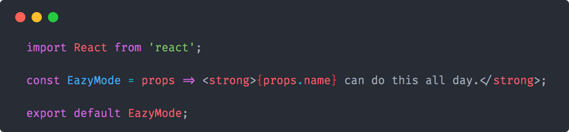
Why GraphQL?
Better data layer
Notes:
If all we had to do as UI developers was write functional, stateless components we probably wouldn’t have jobs anymore. The real difficult parts of building UI happen in this data layer. Flux implementations like Redux give us the tools necessary to solve these problems but they don’t actually solve them for us. In my opinion they are bare bones tools. The path to building a complete data layer from scratch on top of a flux implementation is lined with questions, blog posts, and a lot of misdirection.

Slide 25
Why GraphQL?
Better data layer
🤔
Notes:
The first few times I built a Redux store I did it wrong. Unless you already have the experience and foresight to consider things like cacheing, batching, optimistic update, real time data, etc, from the beginning there’s a good chance you’ll need rewrite your data layer at some point during the development cycle.

Slide 26


Why GraphQL?
Better data layer
Notes:
There is a better way, though. Due to the normalization of GraphQL data our GraphQL clients can make some large assumptions and remove the need to build out much of this data layer infrastructure by hand. We’ve found that using a GraphQL client instead of a hand rolled flux architecture simplifies our UI application codebase by a large margin. Personally, I’d say by an order of magnitude. No more orchestrating requests, no more mapping remote data to our client side state shape, no more writing imperative code to resolve our data dependencies.

Slide 27
Why GraphQL?
Better data layer
Better component APIs
Data modeling
Notes:
The next largest improvement we found were better component APIs.

Slide 28
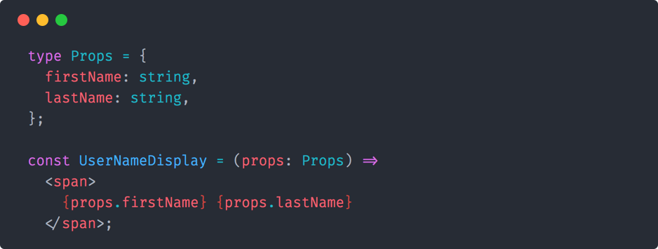
Why GraphQL?
Better component APIs
Notes:
As a UI developer I spend a lot of time considering component APIs and how other developers interact with them. Do we pass scalars as props? Or objects? Or some mix? How do we namespace our props? We use prop type declarations to improve the development experience and avoid type errors but they don’t tell us that much. Consider this example: can we pass in any string as a first or last name? Or just ones from a specific data source?

Slide 29
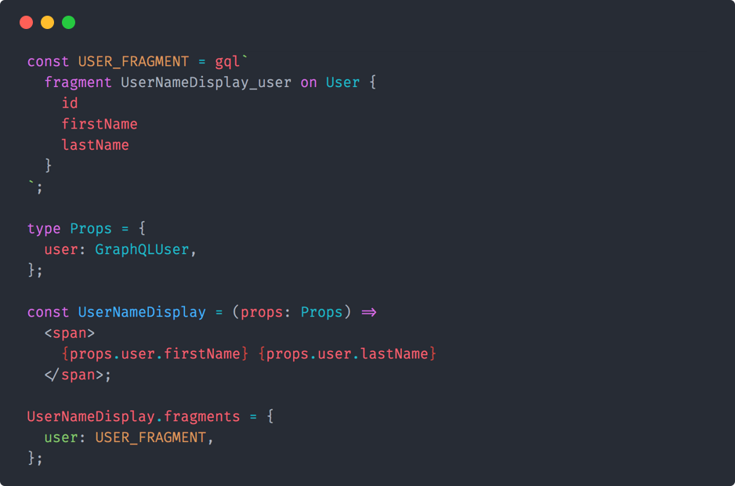
Why GraphQL?
Better component APIs
Notes:
Once our components speak GraphQL a lot of these questions start answering themselves. Instead of passing random values between components we pass GraphQL types. Nearly any component in our User domain accepts a User GraphQL type as its main prop. Simple.
In addition to simplifying questions around component APIs the use of GraphQL fragments also tells us a lot about where our data comes from. This is a very powerful tool as we can define data dependencies statically without having to “connect” the component directly.

Slide 30
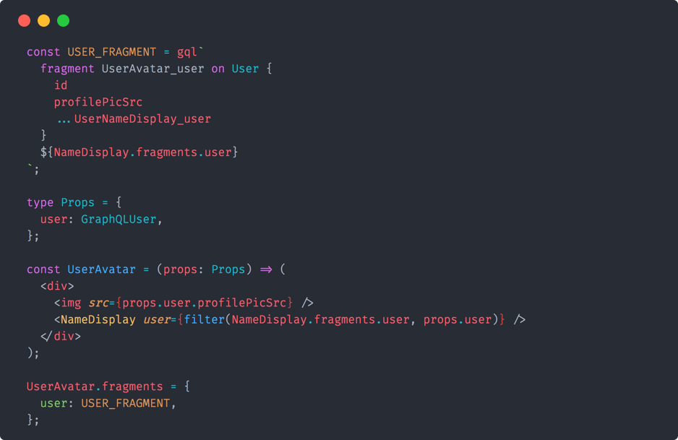
Why GraphQL?
Better component APIs
Notes:
Components further up the tree can then compose these data dependencies via fragment composition. In Redux it’s common to follow a container / presentational component pattern as a way to enforce a basic separation of concerns.
This pattern works out great until your deeply nested presentational component change their data dependencies. All of a sudden your connecting components all over the element tree. With GraphQL we can blur the lines between container / presentational with static data dependencies described as GraphQL fragments.

Slide 31
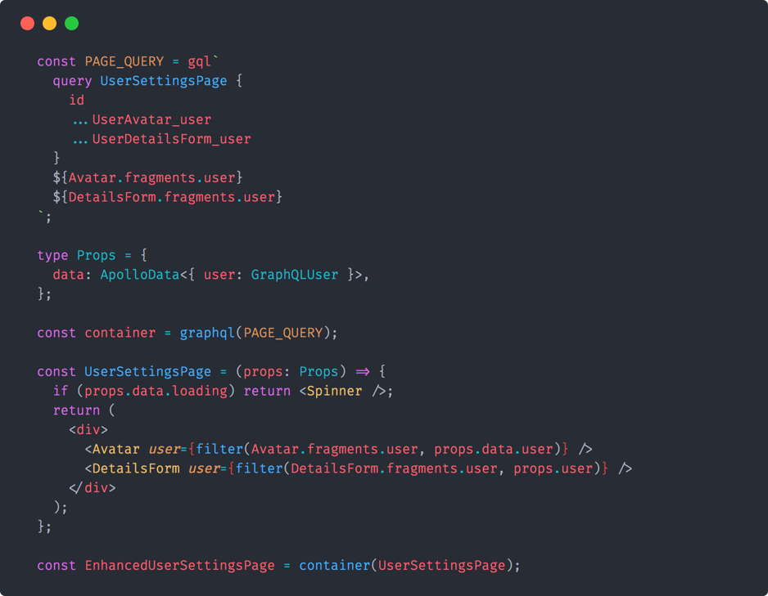
Why GraphQL?
Better component APIs
Notes:
Finally, near the top of our element tree, we actually “connect” to our data sources. Our page level components can “accumulate” the data dependencies of all their descendants and resolve that data all at once.
Previously we had “cascading” data dependencies happening as components all over the element tree independently resolved their data. This resulted in a lot of complex loading states, possible race conditions, and general over fetching. With GraphQL these issues have all but disappeared.

Slide 32

Why GraphQL?
Better component APIs
Notes:
This GraphQL flavor of the container / presentational pattern has worked very well for us. Many times a developer can build out entire features without ever having to touch a container or directly interact with the data layer. They simply write functional components with static data dependencies described as GraphQL fragments.

Slide 33
Why GraphQL?
Better data layer
Better component APIs
Data modeling
Notes:
The last major improvement comes from the data modeling capabilities of GraphQL. As React developers we can sometimes neglect the modeling step in building a data layer. We jump straight into implementation. We install Redux and we start writing actions, reducers, selectors…

Slide 34
Why GraphQL?
Data modeling
GraphQL types > Action types
Notes:
Some of the biggest mistakes I’ve made as a UI developer started just like that. GraphQL formalizes this data modeling step for us. As you build your schema you will be pushed to model your data in a graph, which alone is it’s own benefit. Graphs provide a very natural way to describe and request data.
In addition you will need to statically type all the possible values that pass through the GraphQL layer which can then serve as the source for codegen’d JavaScript type annotations for the rest of your application. These days the first think I write down are my GraphQL types, everything falls into place easily after that.

Slide 35
Next
Notes:
Our setup at Docker has worked out great so far. Other than the increased bundle size we haven’t really seen any negatives. However, we know there is room for improvement. We’d really like to move our GraphQL interface to the server and reconsider the structure of our core services.

Slide 36
Next
Current
Notes:
Unfortunately we can’t directly replace our existing REST API with a GraphQL one. For one, our customers rely on it — the downside of having a “public” API. In addition, it’s not currently built as separate layer. The next step would need to be another hybrid approach.

Slide 37

Next
Step 1
Notes:
Moving GraphQL to our server layer is not so complicated. The majority of the work required is exterior to GraphQL, mostly just getting a production grade Node server configured and approved. I believe the codebase for our GraphQL interface should remain nearly untouched during this transition.

Slide 38

Next
Step 1
Notes:
With Docker containers we can improve this architecture a bit by having our GraphQL server running on the same node (or machine) as our REST API. In this setup they would share a network which would minimize the additional overhead.

Slide 39

Next
Step 2
Notes:
After moving our GraphQL interface to the server our next step would be to remove it’s dependency on the REST API. This is a much larger task as it effects the stack at a much higher level. In the most optimal scenario I see our services exposing themselves via something like gRPC, with both a REST and GraphQL interface in front of it.
By abstracting away the REST layer from our core services we can unshackle ourselves from our public API which would be a huge step forward. The service layer would be much simpler (no more Swagger!) and the REST interface could share much of the same code with the GraphQL interface — Node HTTP server, JS models, testing tools, etc.
Right now our UI team doesn’t own any of the server infrastructure in our applications. One of the thing I’ve come to realize after working with GraphQL is that UI developers know good APIs because we are the primary consumer of them. GraphQL gives us a chance to build better APIs and I believe it’s within our domain as UI developers to build and maintain them. Going forward I would love to see our UI team completely own our API interface layer in our products.

Slide 40
Future
Notes:
While our approach to GraphQL is novel at the moment I can envision a future where running GraphQL on the client is not uncommon.

Slide 41

Future
Ðapps
Notes:
I’m sure many of you are already familiar with the concept of “dapps”, or decentralized applications. In the “dapp” paradigm we rely on decentralized, blockchain networks instead of centralized, private server infrastructure to host the remote portions of our application. The end user interacts with an application running on their device to communicate directly with the blockchain. This interaction is made possible via things like the Web3 JavaScript API for the Ethereum blockchain and browser extensions like Meta Mask. This architecture begs a question, though. With no server between the end users device and the blockchain where does GraphQL fit in?

Slide 42

Future
GraphQL + Web3
Notes:
It fits in on the client. Using GraphQL and a local schema we can write resolvers that call the Web3 APIs exposed on the users device to communicate with the blockchain. Running GraphQL on the client in a world of “dapps” doesn’t seem that crazy. That’s not to say we wouldn’t have some remote GraphQL infrastructure as well.

Slide 43
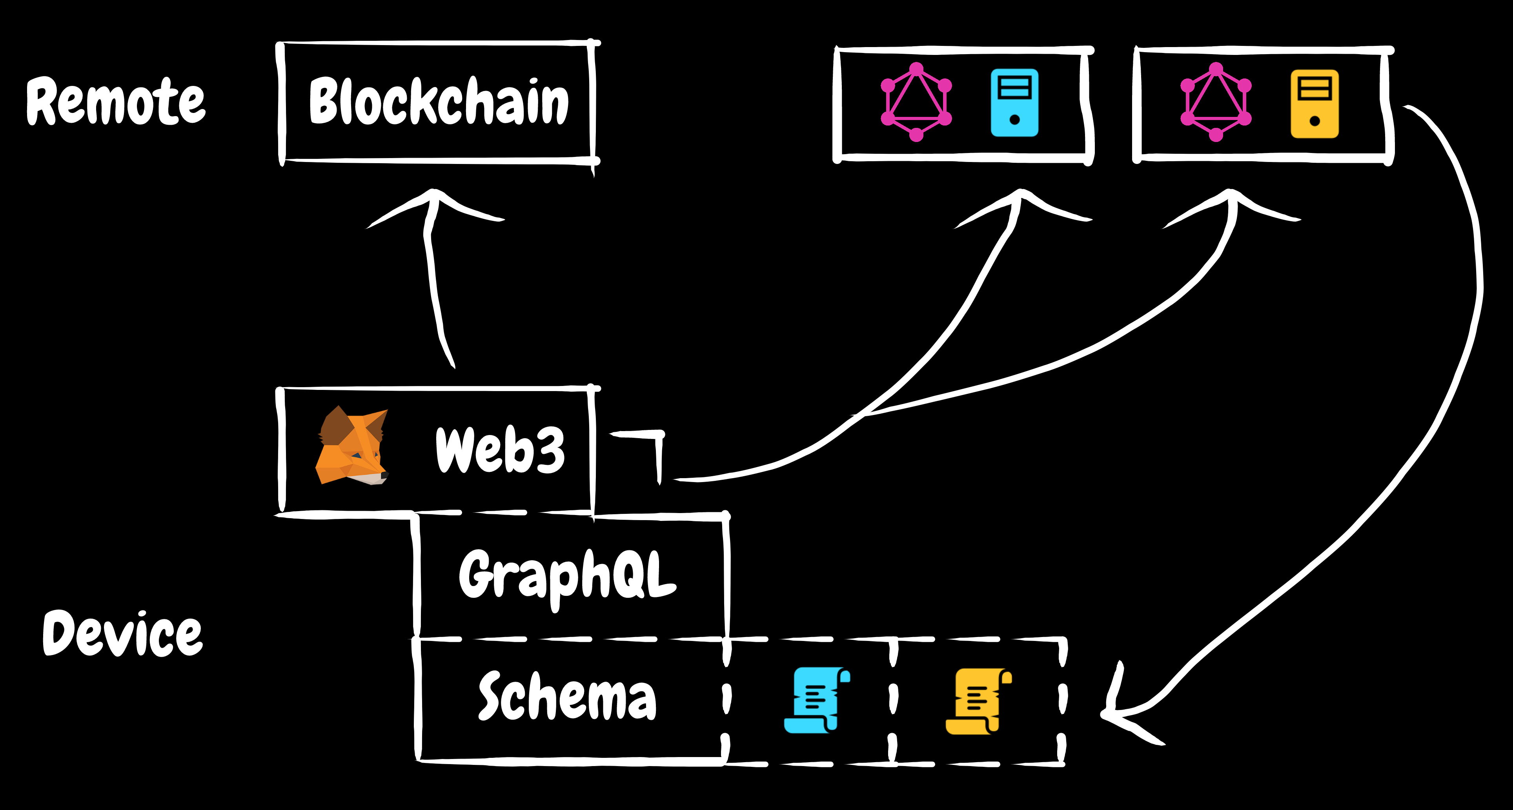
Future
Schema stitching
Notes:
The ad-hoc server infrastructure in our application could easily be GraphQL based. Using schema-stitching methods we can combine remote GraphQL services together with our local schema to produce a universal interface for our “dapp”. Blockchain tech presents some really exciting possibilities for UI developers. If the “dapp” revolution comes to be our UI applications will take on new life with a much larger role in our stack.
React and GraphQL are a fantastic pairing that can help us build the applications of today and tomorrow.

Slide 44
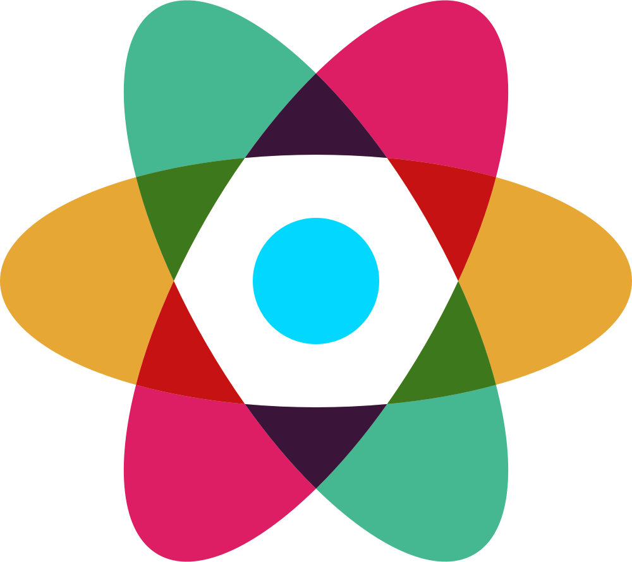
👇 contact
✉️ slightlytyler@gmail.com
@slightlytyler #graphql
slides available at: https://bit.ly/graphql-outside-the-box
Notes:
If you have questions about our approach or just want to talk GraphQL you can reach me in these places here or in the hallway during the conference. Other than the hallway Reactiflux is your best bet. One last note: we’re hiring senior front-end engineers at Docker so if you like React and GraphQL and are looking for a job let’s chat.

Slide 45
thanks :)
Notes:
Thanks!

